Slide 1
ALL OFFICER TRAINING
March 5, 2024 Dual Presidential Primary
Notes:
No video or audio for EOs. Open chat box. Questions will go into the chat box. We know you are being helpful when you answer questions, BUT let the staff answer the questions in chat. Ask for clarification if necessary.

Slide 2
Introduction and Housekeeping
This training is for all PWC Election Officers. We will cover a lot of information. Some of it is directed to the Chiefs and Assistant Chiefs in the room, but it is all good information for everyone to have. If there is something you are not clear on, your Chief will be able to clear it up on Election Day.
Notes:
Introduce self and Alexis to people in the room. Restroom, cell phones on silent, respect others talking or talk about virtual training. Thank EOs for becoming EOs. Questions along the way, wait until we call for questions. Must be registered in Mobius to get paid. There is option to waive pay. If banking info changes or they relocate they need to update Mobius. Mobius is its own entity.

Slide 3
Supply Pickup
Pick up supplies at 13851 Telegraph Road, Suite E, Woodbridge, VA.
Thursday, Feb 29th from 12pm-7pm
Friday, March 1st from 9am-7pm
Saturday, March 2nd from 9am-12pm

Slide 4
Updates to the Manual for March Primary
The booklet will be posted on the Website.
March updates will be in a booklet as shown.
We recommend that you print it from the site.
We will also have some in the Chief Bag.
Notes:
We will also have them at Buckhall VFD during the open house/work shops.

Slide 5
General Information
About > This Election
Election Day: March 5, 2024
Type: Dual Presidential Primary
Work hours: 5:00 am - ~ 8:30 pm
Voting Hours: 6:00 am – 7:00 pm
Monday Setup: Available
Officer in Charge: Chief Officer

Slide 6
DUAL PRIMARY
About > This Election
In Virginia, we do not register to vote by party.
Open primary state
Two primaries on same day, voters must choose which primary to vote in by answering the following question: Which Primary are you voting in today?

Slide 7
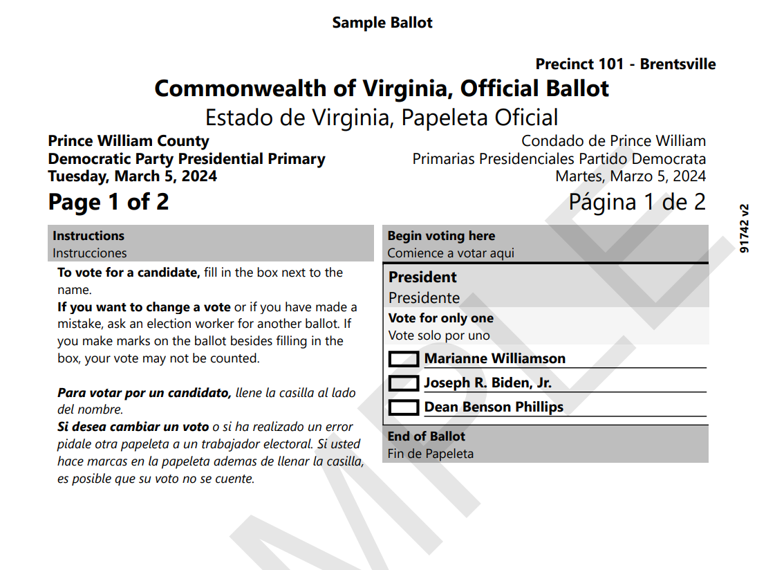
SAMPLE BALLOT
Notes:
Ballots have been approved and printed. Names cannot be removed from the ballot. There will be names on the ballot of candidates who have dropped out of the race. If we are notified that a candidates has gone through the official process to drop out of the primary, we will have signs posted in the precinct. We will talk about a voter who wants to change the ballot they ask for later.

Slide 8
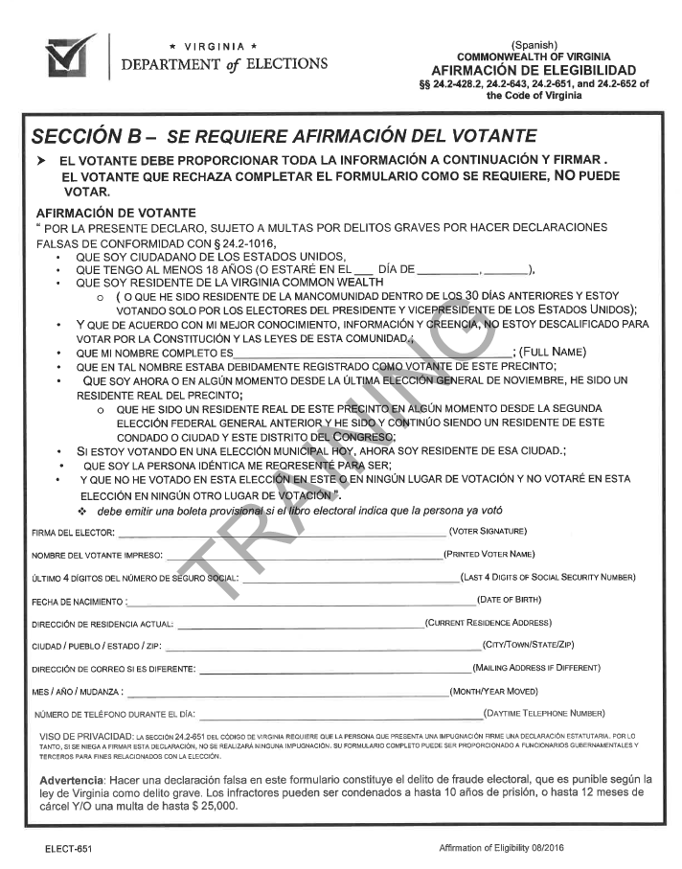
Affirmation Of Eligibility
Notes:
This form is in your blue accordion folder. There are two forms in the folder. One has English on the section A side and the section B side. The other has English on the A side and Spanish on the B side. They are in two different marked pockets in the accordion folder. When using this form the voter will always complete the B section. Ensure you give the voter correct form. Only give the Spanish form to a voter if they request it.

Slide 9
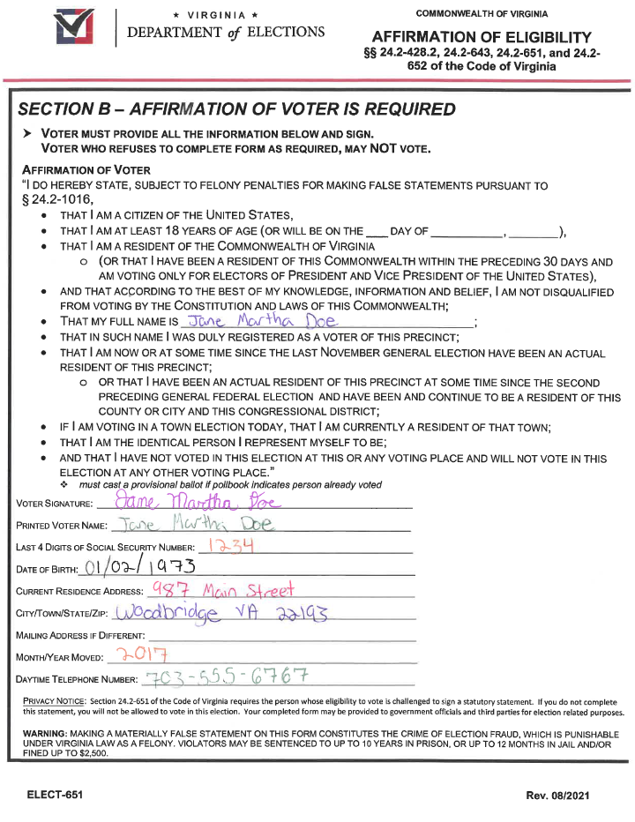
Completed Affirmation of Eligibility
Notes:
These items must be filled out. Walk through the form. There are only three choices, don’t add another (“D”). Highlight “A”, don’t use “B”, and highlight “C”. If you check “C” someone must complete the challenge section. Voter must always complete Section “B” on the back of the form. If voter refuses to complete form as required call Chief HQ.

Slide 10
Chief Choices On Form
Notes:
Check “A” if ? And Voters Name or address has not changed. We don’t use “B”. Check “C” if voter is challenged by another voter or an EO.

Slide 11
When Chief Needs to Challenge Voter
Pollbook says voter has already voted.
Voter moved to a different precinct within the same county/city AND congressional district.
There may be a ? next to voter’s name or the pollbook says ‘inactive’ or ‘marked for address confirmation.’
Voter moved from November 4, 2020, through November 7, 2023.
Officer fills out and initials Section A on the Affirmation of Eligibility form and checks Box C and Box 4.
Voter fills out and signs Section B – Affirmation of Voter using their new address.
Notes:
In this case you are following the What-ifs and the Move Rules.

Slide 12
When Chief Needs to Challenge Voter (cont)
Officer checks voter into the pollbook and indicates in the pollbook that a statement or oath was signed.
Voter casts ballot as normal in precinct where still registered.
Place form in envelope #8.

Slide 13
Questions

Slide 14
Provisional Voting
Use of the Provisional Log in Tallypoint was AWESOME in November!!
The Provisional process overall was good, but let’s make it better.

Slide 15
Where To Keep Provisional Ballots
You will be given provisional ballots at Supply Pickup.
Regular ballots will be in the cage.
Take the regular ballots from the cage and place them at the check-in table by 6 am.
Place the provisional ballots at the Chief/Provisional table.
Notes:
The precinct must be ready for voters at 6am. That means at least one pollbook ready to check in voters, The Scanner ready to scan ballots, and the ballots are at the table ready for voters to check. We want the voter to get the correct ballot the first time. Regular ballots from the check-in table, provisional ballots from the Chief/Provisional table.

Slide 16
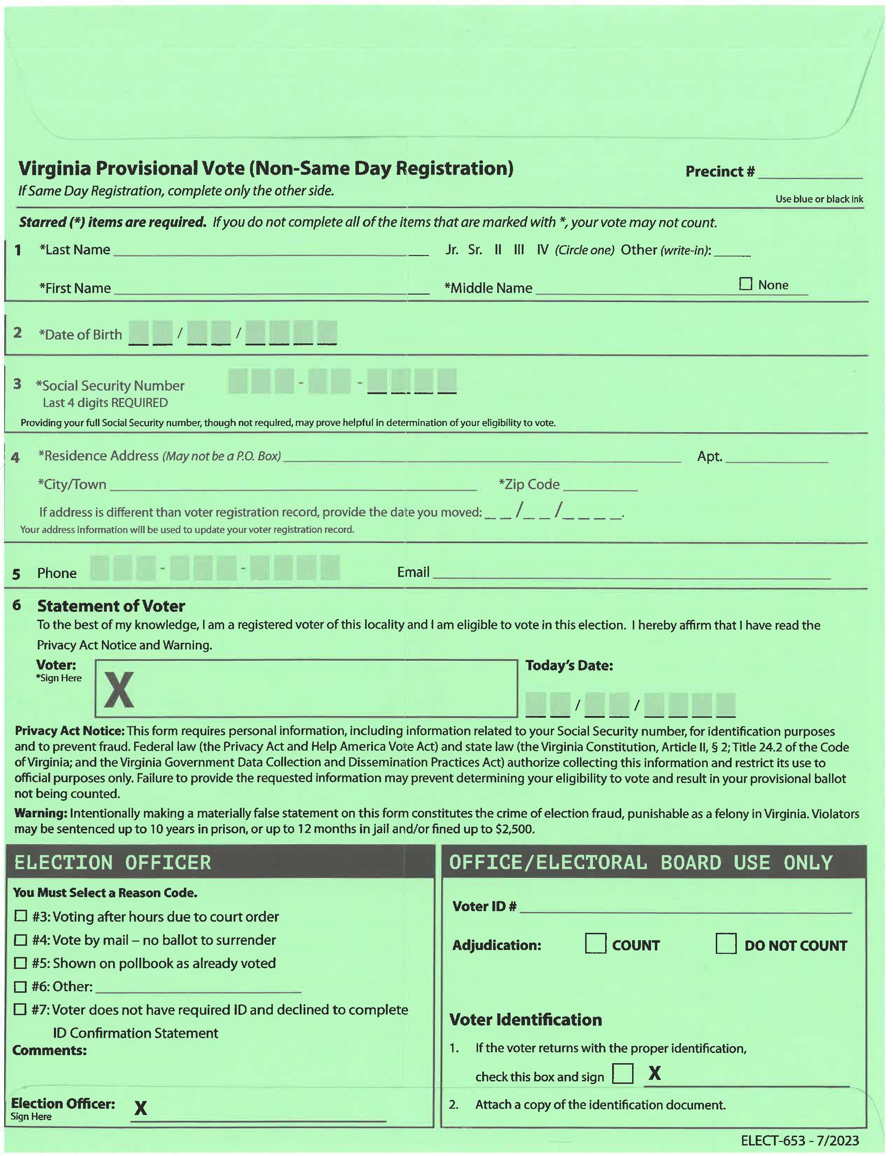
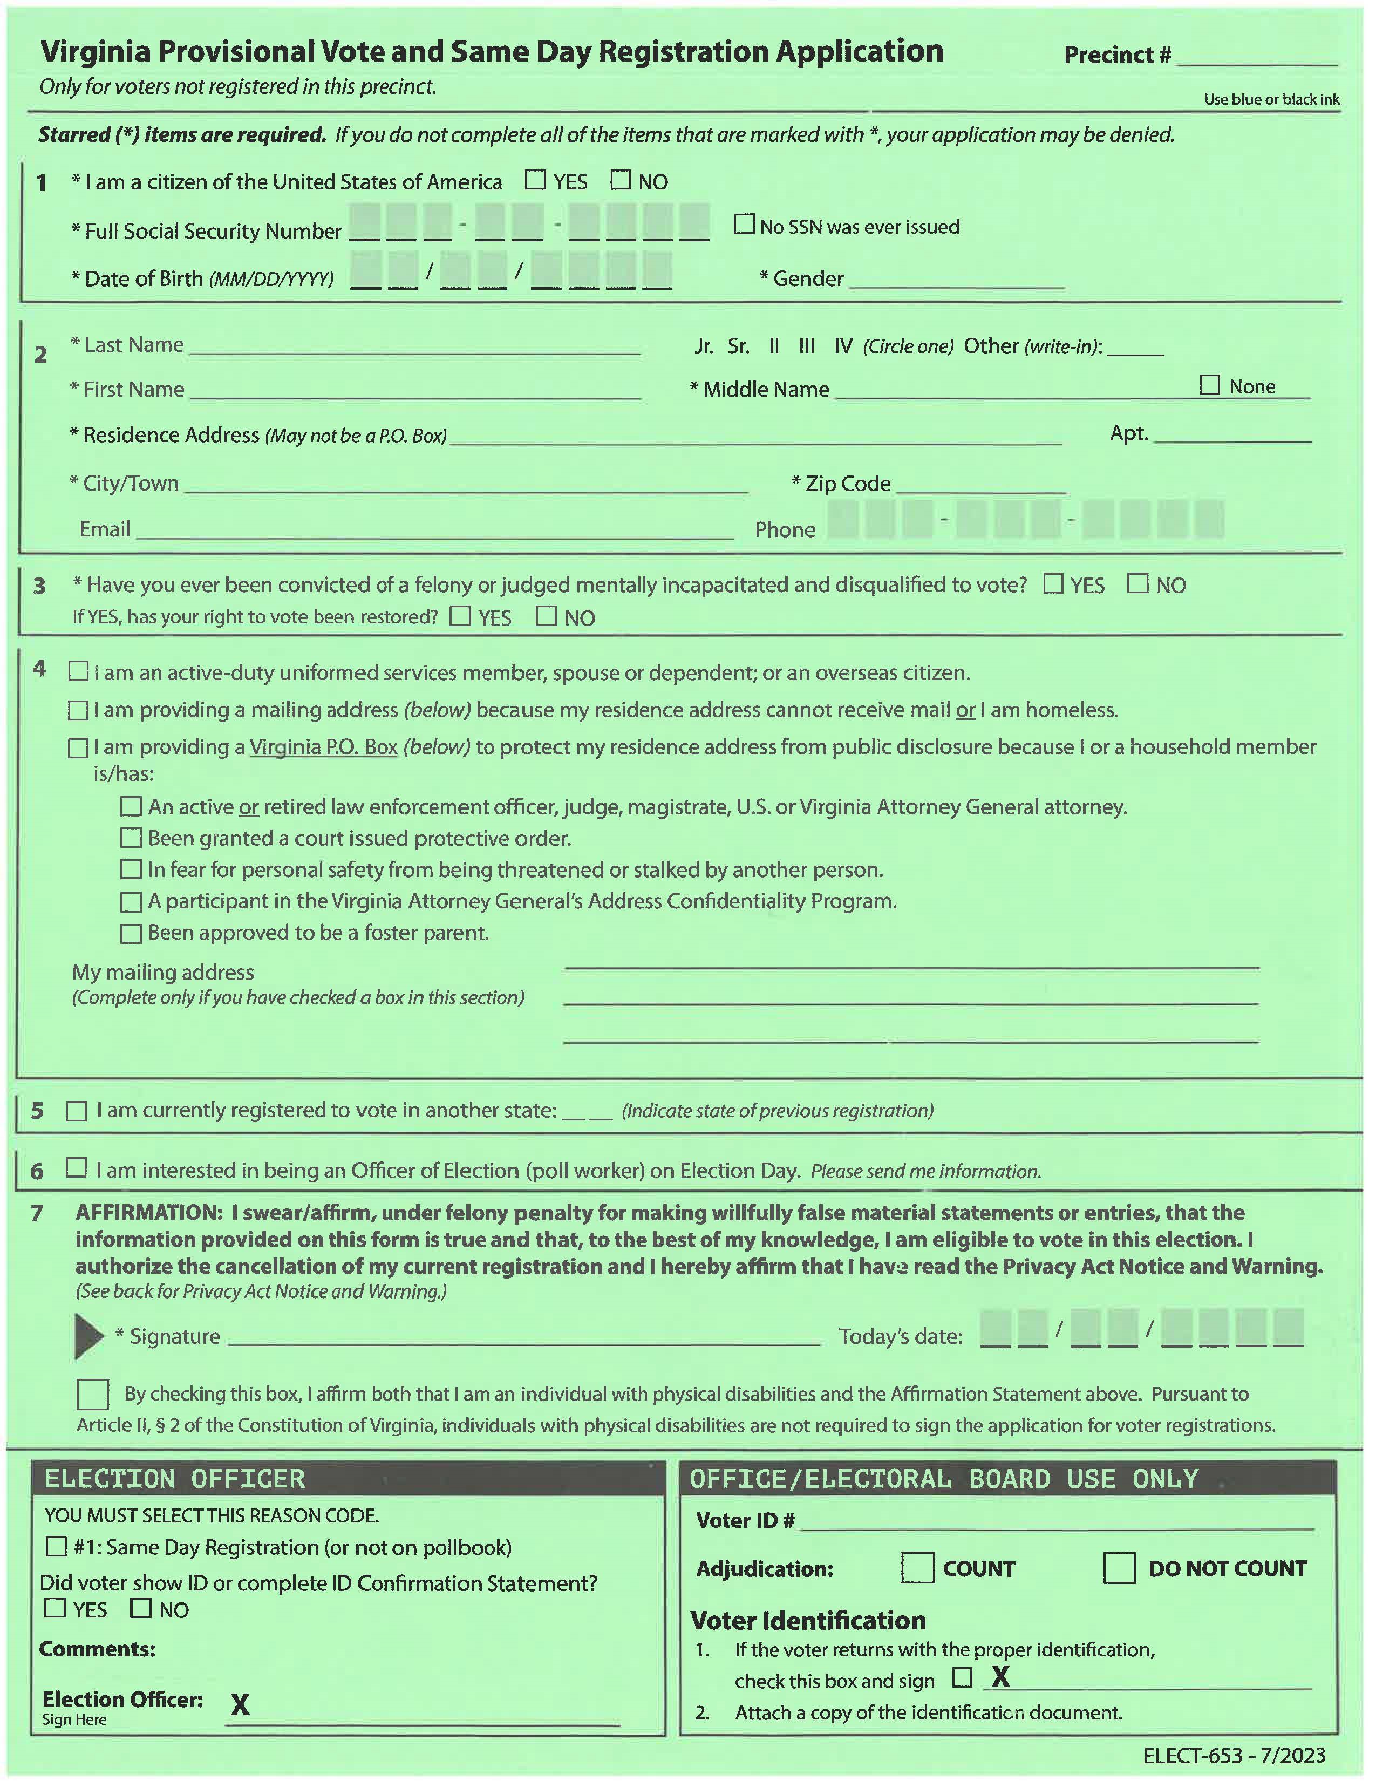
PROVISIONAL BALLOT ENVELOPE
Same Day Reg (Front)
Non-Same Day (Back)
Notes:
The Provisional Ballot Envelope – two sides. Talk about #3 on the SDR said. Talk about reason codes on both sides. Other should only be used after talking to the Election Office. If you have comments to add keep it short, just the facts please.

Slide 17
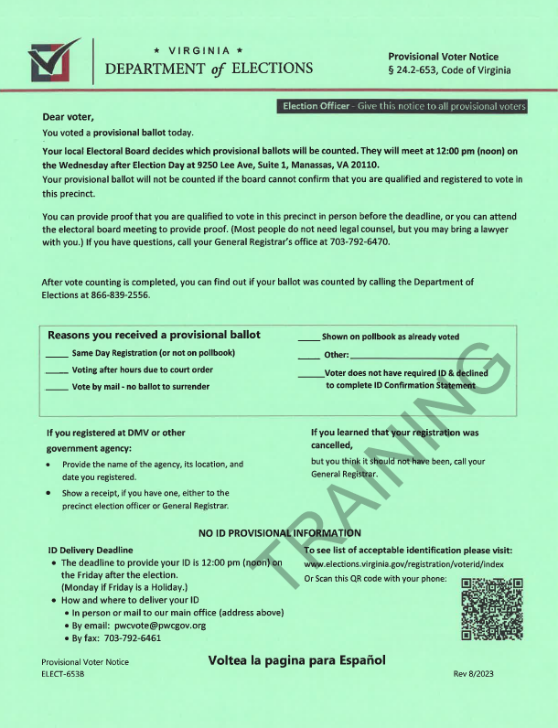
Notes:
Explain the Provisional Voter Notice

Slide 18
Check-in Process on EPB
Chief, please monitor the check-in process.
Problem – not completing the check-in process.
Solution – complete the process.
Do not give voter ballot until you see the voters name in RED on the search screen.
If pollbooks are not connected, only use one tablet until they are connected.
Notes:
Completing the check-in process will take care of most of your discrepancies between the Pollbook and the Scanner. Monitor the check-in process at the start of the day and whenever you add someone to the EPB for the first time. So how do you complete the process? Good question.

Slide 19
PROCESS TO CHECK IN A VOTER
Ask voter for identification and verify it is an acceptable type of identification. If voter does not have acceptable identification, they can complete the ID Confirmation Statement instead.
Look up voter on the pollbook using manual entry or the hand scanner (for licenses or voter registration cards).
Select the correct voter on the pollbook.
Ask the voter to confirm full legal name and current residence. (Voter can state it was already given with the identification instead of stating out loud.)
Manual Page 75

Slide 20
PROCESS TO CHECK IN A VOTER (cont.)
5. Verify the information on the pollbook is correct. If address does not match the pollbook or the voter is flagged, send them to the Chief/provisional station.
6. State aloud the name of the voter only. Do not state the address aloud.
7. Click the “Check In Voter” button in the pollbook.
8. Click the “Continue” button.
9. Click “OK” button.
10. Give the voter a ballot in a privacy folder.
Manual Page 75
Notes:
After step 7 is another step only used during primary elections, we will see that shortly. We are not going to look at all the screen shots today, but

Slide 21
Notes:
This is the pop-up that comes after you click Check Voter In. Tell them to READ FROM THE POLLBOOK. Do not ad lib. Just read it word for word. If they don’t want to tell which primary they want to vote in tell them this. “Virginia is an open primary state. We don’t register by party and if there are two primaries on the same day voters must choose which primary to vote in.” We will only give them one ballot. What if they change their mind?

Slide 22
PROCESS TO CHECK IN A VOTER (cont.)
Voter Check In > Process
Notes:
Now you are back on the search screen. It brings you back here automatically. Julie Fisher has been checked in, her name is now highlighted in red, and she is walking away from your station with a ballot. To check in the next voter, either scan the VA DL or start typing. It will start a new search. Information – When you search for a voter if the name is highlighted in red send that voter to the chief.

Slide 23
Voter Changes Mind After Receiving Ballot
Check In > Need to Know
Voter has been checked in and given a ballot.
Voter decides to vote in the other primary.
Send voter to Chief with the ballot they were given.
Notes:
The code allows a voter to change their mind about which primary the wish to vote in after receiving a ballot. The voter must turn the ballot into the Chief. Chief must “uncheck them in,” then have them go to the end of the line to be checked into the other primary. If the voter changes their mind again and it is hindering or delaying other voters, the EOs in that precinct may vote for the voter to leave the precinct.

Slide 24
Year of Birth in RED
Notes:
This should help with the Jr Sr State on the pollbook. The year of birth will be in red.

Slide 25
Questions

Slide 26
Can a voter write in a candidate?
Can a voter take a selfie with a ballot?
Can a voter put more than one ballot into the Drop Box?
Can you help a voter fill in their ballot if they request you to?
Notes:
1. Write-ins are not allowed during a primary election. 2. Voter can take a selfie and a picture of their own ballot. 3. A voter can put more than one ballot into the Drop Box. 4. If a voter requests your help, they must complete a Request for Assistance form.

Slide 27
The SOR for this election.
Notes:
Talk about the Statement of Results. Smaller, one sided,

Slide 28
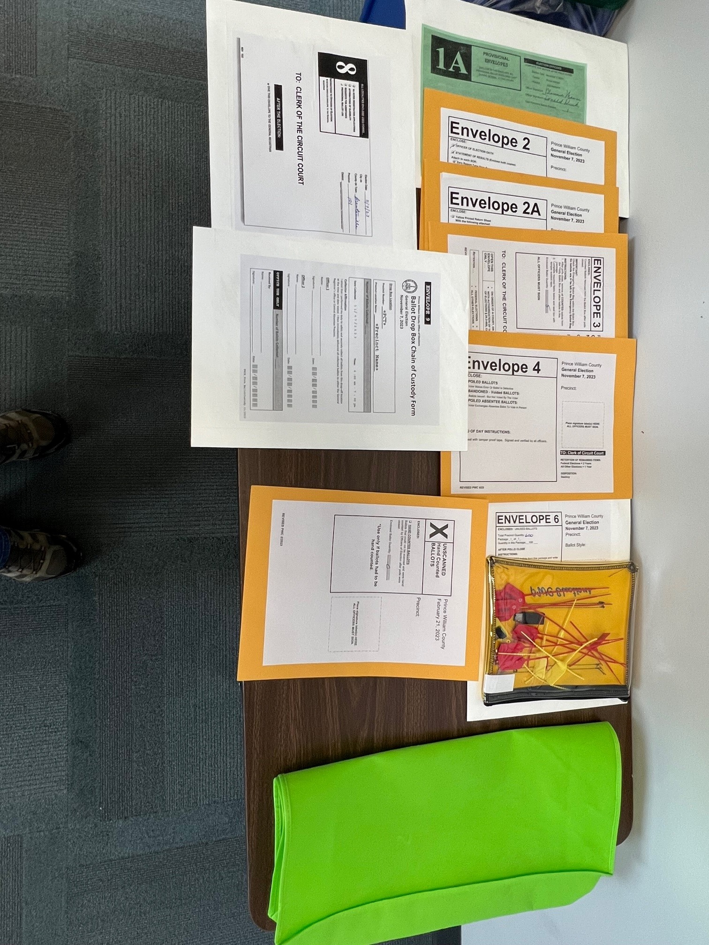
End of Night Envelopes
Closing The Polls
Notes:
Lay them out, fill them during the day, have an officer ensure the papers are in the correct envelope, gather all EOs around the table and make sure are paperwork is complete and signed.

Slide 29
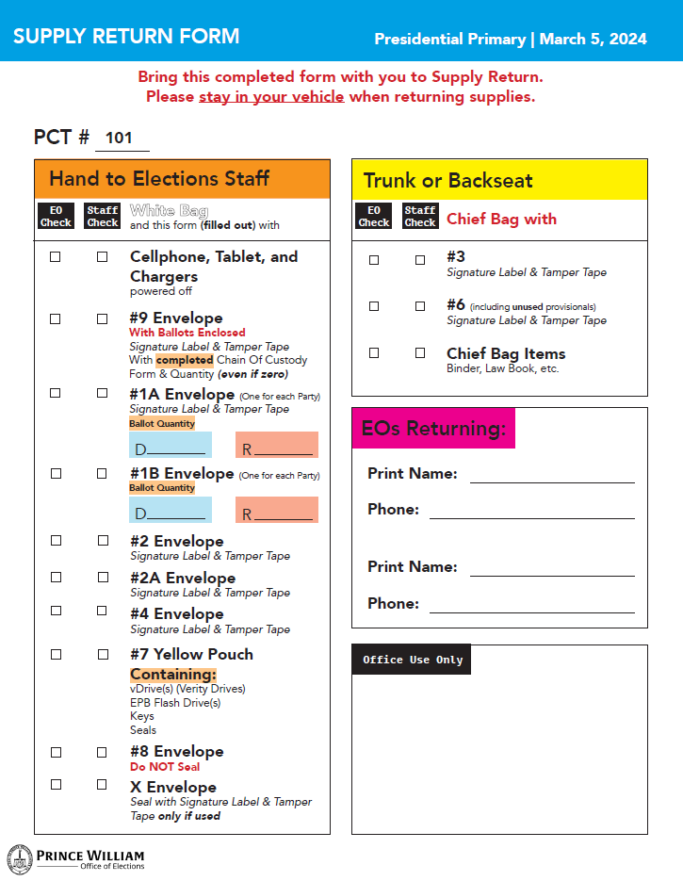
Notes:
Here is the Supply Return Form. Please fill it out before you leave the precinct. Point out important items!!

Slide 30
DE-ESCALATION
The Polling Place
Remain Calm.
Listen to voter.
Explain the issue.
Send voter to the Chief.
Call Chief HQ.
Notes:
There are times a voter will tell you the poll book is wrong, or will not want to tell you which primary they want to vote in. Another question may be why is a certain candidate is still on the ballot. Above all else Remain Calm. If you know the answer, explain it to the voter. In most cases the voter will end up talking to the Chief.

Slide 31
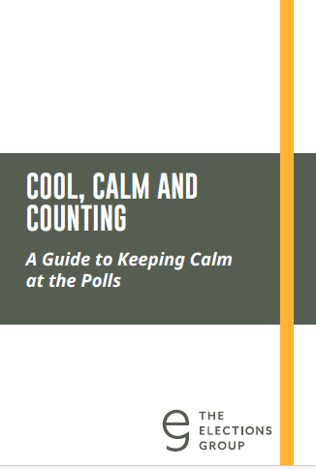

Slide 33
What is Unlawful in the Polling Place and the 40-foot Prohibited Area
Possessing a firearm within the 40-foot area or within the polling place. Law enforcement officer in or out of uniform allowed.
Loitering or congregating.
Hindering voters or election officers.
Notes:
Weapons not allowed from 1 hour before polls open until one hour after polls close. This does not include local. state, or federal law enforcement. Voters cannot stay in polling place after casting vote. Cannot block sidewalk and gate into location. Authorized Reps are those who are permitted by a pollical party to remain in the polling place during the election.

Slide 34
Unlawful in the Polling Place
Authorized Representatives cannot assist voters.
Campaigning or showing any sample ballot or other campaign material.
Attempting to influence any person casting a ballot.
Looking at the marked ballot of any voter.
Only Voters can wear campaign apparel.
Notes:
Observers cannot talk politics to voters, EOs, or among themselves. Observers are there to observe, if they have questions refer them to the CO. Once voters have their ballot they are to vote, not discuss the names or issues on the ballot. We will show how to minimize talking shortly.

Slide 35
What is Allowed Outside the 40-foot Prohibited Area
Campaigning that does not hinder voters.
Media may do interviews and broadcast remarks. May not conduct interviews inside the polling place.
Notes:
Campaigners cannot not block voters from entering the polling place. News media may visit and film inside the polling place for a reasonable and limited period while polls are open. They may not film anyone who requests not to be filmed and may not film a voter's marked ballot. Only voters can wear these things into the polling place. Officers of Election nor Authorized Reps cannot wear these things inside the polling place. EOs, don’t wear these items to the polling place. Remember you are Non-Partisan on election day.

Slide 36
What is Allowed in the Voting Booth
Sample ballots.
Campaign materials.
Voters are allowed to do research on their cell phones while in the voting booth.
Voters can take pictures of themselves or their own ballot.
Notes:
Voters should take anything they came with when they leave. If they leave campaign material in the voting booth the EOs will toss the material in the trash. If they leave personal items give it to the CO. Voters cannot take pictures of other voters’ ballots or otherwise disrupt the election.

Slide 37
Machine Open House/Work Shop
Buckhall Volunteer Fire Department
7190 Yates Ford Rd, Manassas
February 23rd: 12:00 noon – 4:00 pm
February 29th: 3:00 pm – 9:00 pm
March 1st: 9:00 am – 3:00 pm
Notes:
This is where you come to get hands on practice. We will have the Scanner, TW, Pollbooks, iPads for Tallypoint, and envelops and forms for “End of Night. No training, self practice so bring your manual. We will be there to assist if needed.,

Slide 38
Questions

Slide 39
Final Notes
Conclusion
Thank you again for becoming an Election Officer!
Election Officer website: https://www.pwcvotes.org/electionofficer
If you have not heard from your Chief 3 weeks BEFORE the election, send an email to electionofficer@pwcgov.org or call Dena (staffing coordinator) at 703.792.6485.

Slide 40
After I read the Oath, say “I will”
Officer Oath
“I do solemnly swear (or affirm) that I will perform the duties for this election according to law and the best of my ability, and that I will studiously endeavor to prevent fraud, deceit, and abuse in
conducting this election.”

Slide 41
After I read the Oath, say “I will”
Appointment Oath
I do solemnly swear (or affirm) that I will support the Constitution of the United States, and the Constitution of the Commonwealth of Virginia, and that I will faithfully and impartially discharge all the duties incumbent upon me as an Officer of Election of Prince William County according to the best of my ability.

Slide 42
Have a great election!

Slide 43
Quiz and Oath
Quiz and Oath
https://forms.gle/7vwEy9nAw2UKVaXa7

