Slide 1
EARLY VOTING ORDINANCE
2024 UPDATE
PRINCE WILLIAM COUNTY, VIRGINIA

Slide 2
OFFICE OF ELECTIONS
Have evaluated current early voting locations and voting patterns
Have recommendations for adoption of a new ordinance

Slide 3
CONSIDERATIONS & GOALS

Slide 4
EARLY VOTING
Required at the Main Office by 45 days before the election
Counties and cities can establish additional satellite locations with varied days and hours

Slide 5
CONSIDERATIONS
Early Voting satellite offices must be established by local ordinance
Most counties do not have satellite locations, but it is more common in large counties

Slide 6
CONSIDERATIONS
Mail voting has become popular and is growing
More data now exists to examine early voting participation and patterns

Slide 7
EARLY VOTING SITE REQUIREMENTS
Accessibility of facilities
Adequate parking available
Public building (own or lease)
Adequate room size
Security of equipment/materials
VA Code § 24.2-701.2 lists requirements

Slide 8
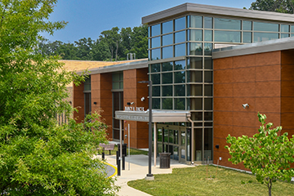
PWC CHALLENGES
Limited space at each early voting site
Limited number of PWC locations appropriate for early voting

Slide 9
OVERALL GOALS
Sufficient access to early voting for all voters
Geographic balance across the county
Cost effective use of public funds
Give voters consistency

Slide 10
CURRENT ORDINANCES

Slide 11
EARLY VOTING CURRENT ORDINANCE
Primary General
Opens # of Days Opens # of Days
Location Before Election Before Election
Office of Elections * 45* 45*
Haymarket Gainesville Library 45 45
A J Ferlazzo Building 45 -
DMV (Caton Hill Rd) - 45
Brentsville Courthouse (Historic) - 14
Dumfries Community Center - 14
*Required by VA Code

Slide 12
2022 GENERAL ELECTION EARLY VOTERS
Map Provided by Prince William County GIS

Slide 13
ACCESS
HAY
OFFICE
Primary:
Few sites, active in 2 of 7 districts
FER

Slide 14
ACCESS
HAY
OFFICE
General:
More locations, not too far from most
BRE
DMV
DUM

Slide 15
BALANCE
HAY
Primary:
Good spread geographically but few sites
OFFICE
FER

Slide 16
BALANCE
HAY
Approximate split of county population
Primary:
Not very equal for population distribution
OFFICE
FER

Slide 17
All CURRENT EARLY VOTING SITES
BALANCE
HAY
General:
More sites shows some balance
OFFICE
BRE
DMV
DUM

Slide 18
COST EFFECTIVE
Costs more than $35,000 in staffing, only 42 voters per site per day
2023 Primary Election
First 4 Weeks = 2,532 total voters
Last 4 Days = 2,956 total voters

Slide 19
COST EFFECTIVE
2023 Primary Election
Early Voters By Day

Slide 20
COST EFFECTIVE
2023 General Election
Early Voters By Day
Last day of 2023 Primary
Avg. day of 2023 Primary

Slide 21
CONSISTENCY
Primary General
Location # of Days # of Days
Required - Office of Elections 45 45
Haymarket Gainesville Library 45 45
A J Ferlazzo Building 45 -
DMV (Caton Hill Rd) - 45
Brentsville Courthouse (Historic) - 14
Dumfries Community Center - 14
]
Voters Can’t
Build Habits

Slide 22
First drafts require review, input, and revisions

Slide 23
DATA INPUTS

Slide 24
OBSERVATIONS
Most large localities offer more satellite locations than PWC

Slide 25
COMPARATIVE DATA –
CURRENT PRIMARY
Open All # of Satellite Sunday
45 Days Satellites Days Open Voting
Fairfax County Office + 2 (PM) 13 7 (PM) No
Loudon County Office only 3 7 No
Virginia Beach Office only 5 7 No
Prince William Office + 2 2 45 Yes

Slide 26
OBSERVATIONS
Primary elections are not only much smaller than general elections, but fewer voters use early voting

Slide 27
PWC VOTER TURNOUT
Party Primary General On the
Primary Turnout Turnout Ballot
2020 Dem (Prez) 24% 79% President/Federal
2020 Both (Cong) 12%
2021 Both 8% 50% Gubernatorial/State
2022 Rep 2% 47% Federal
2023 Both 12% 39% County/State

Slide 28
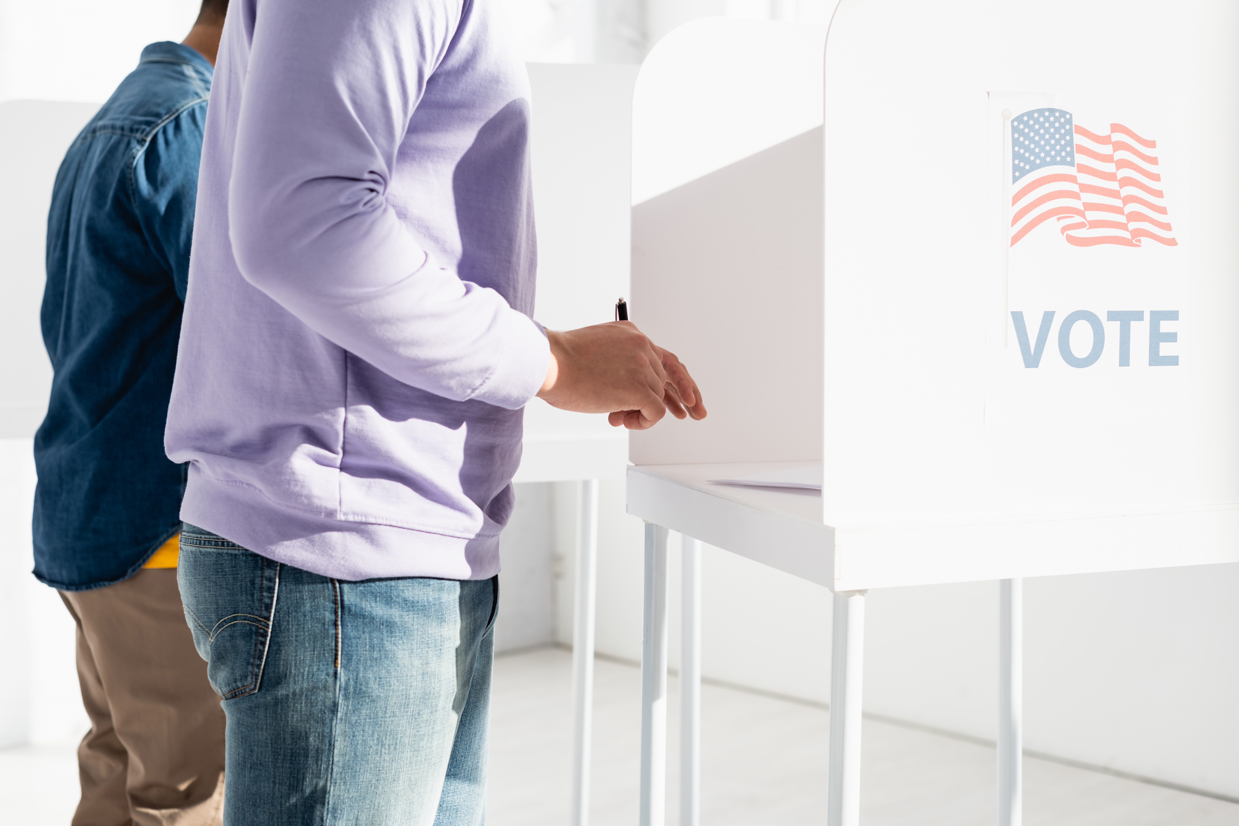
PWC VOTER TURNOUT
Primary Elections
25,000- 40,000 voters
General Elections
120,000 – 160,000 voters
200,000+ for presidential years

Slide 29
% OF VOTERS USING
EARLY VOTING
Primary General % Early % Early
2021 13% 28%
2022 8% 25%
2023 20% 25%
Fewer voters use early voting in elections with lower voter turnout

Slide 30
OBSERVATIONS
Mail voting is not only growing faster than early voting, it is the choice of “early early” voters

Slide 31
PWC – VOTING TYPE
Early
25%
Election Day 60%
Mail
15%

Slide 32
2024 PRIMARY
First two weeks of early voting:
541 in-person voters at early voting
2,474 mail voters have returned their ballots

Slide 33
NEW ORDINANCE

Slide 34
RECOMMENDATIONS
Adopt a new early voting ordinance for all elections by this summer effective for this fall’s presidential election
Expand the number of satellites for access/balance
Use the same locations for all elections for consistency
Adjust the start date of satellite location opening
Define satellite locations for special elections

Slide 35
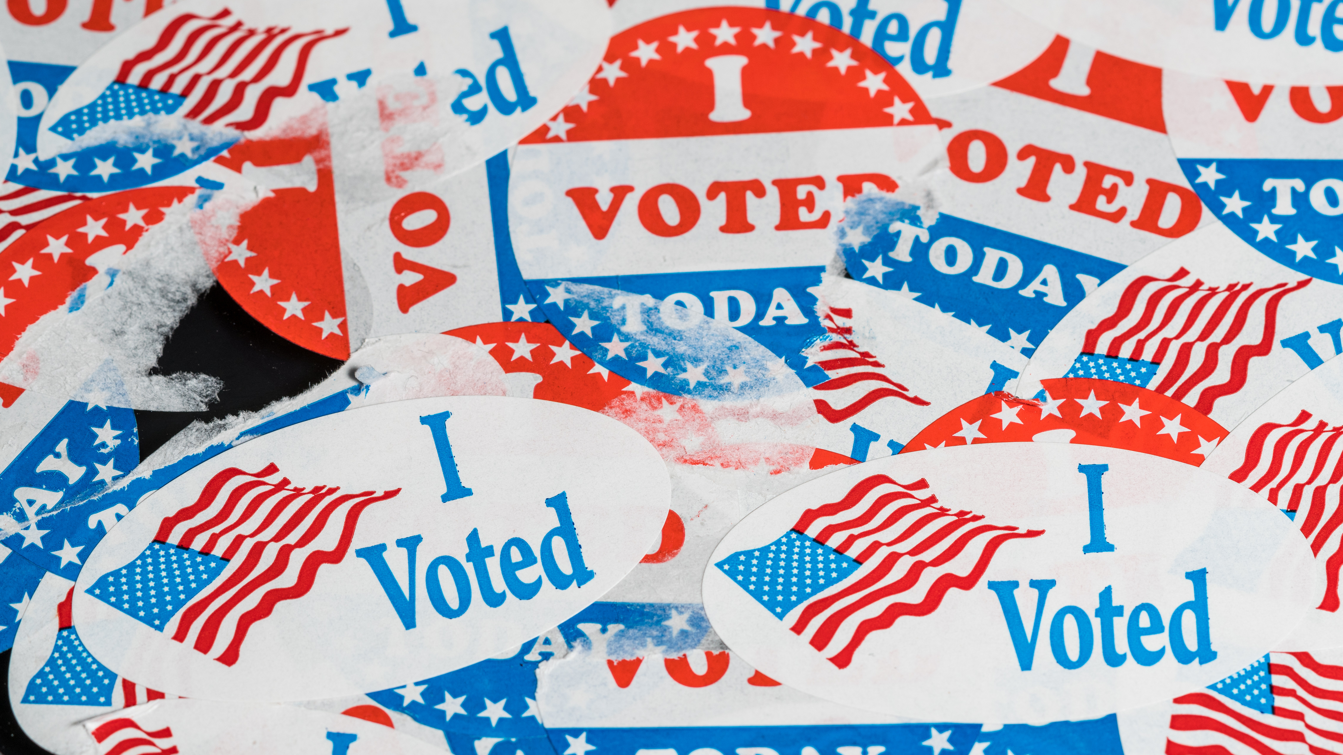
#1: EXPAND THE NUMBER OF LOCATIONS

Slide 36
uSE All CURRENT EARLY VOTING SITES FOR ALL ELECTIONS
HAY
OFFICE
BRE
DMV
FER
DUM

Slide 37
Uses locations known to voters
Provides 3 sites for each half of county population
All magisterial districts close to two early voting sites
HAY
OFFICE
BRE
DMV
FER
DUM

Slide 38
#2: USE THE SAME LOCATIONS FOR ALL ELECTIONS

Slide 39
Voters will know these locations in use whenever there is an election
Only thing to check is the start date of early voting
HAY
OFFICE
BRE
DMV
FER
DUM

Slide 40
START DATE

Slide 41
CURRENT PRIMARY
Office
Hay/Fer
S M T W T F S S M T W T F S
S M T W T F S
S M T W T F S
S M T W T F S
S M T W T F S
S M T W T F S
S M
S M T W T F S S M T W T F S
S M T W T F S
S M T W T F S
S M T W T F S
S M T W T F S
S M T W T F S
S M
KEY
45-Day Mark
Day Site is Open
34 Days Open
34 Days Open x 2 sites

Slide 42
CURRENT GENERAL
Office
Hay/DMV
Brent/Dum
S M T W T F S S M T W T F S
S M T W T F S
S M T W T F S
S M T W T F S
S M T W T F S
S M T W T F S
S M
S M T W T F S S M T W T F S
S M T W T F S
S M T W T F S
S M T W T F S
S M T W T F S
S M T W T F S
S M
S M T W T F S S M T W T F S
S M T W T F S
S M T W T F S
S M T W T F S
S M T W T F S
S M T W T F S
S M
34 Days Open
34 Days Open x 2 sites
11 Days Open x 2 sites

Slide 43
Unused capacity with 5 sites is 3,000 – 4,000 voters per day
Satellites rarely used for most of early voting

Slide 44
NEW STARTING DATES: 1-2-3 SYSTEM
Office Open For Full 45 Days by Statute
All satellite sites:
1 week for Primary
2 weeks for General
3 weeks for Presidential General

Slide 45
NEW PRIMARY (& SPECIALS)
1 WEEK
Office
5 Locations
BENEFITS
Broader access for the public to early voting during its most popular times
3 weekend days for voting
Main Office and mail voting can handle “early early” voters
S M T W T F S S M T W T F S
S M T W T F S
S M T W T F S
S M T W T F S
S M T W T F S
S M T W T F S
S M
S M T W T F S S M T W T F S
S M T W T F S
S M T W T F S
S M T W T F S
S M T W T F S
S M T W T F S
S M
34 Days Open
8 Days Open
x 5 Sites

Slide 46
NEW GENERAL
2 WEEKS
BENEFITS
Sunday start unique and can draw media attention to inform the public, only county open that day
Covers highest voting period without having line issues
3 different weekends of voting, more than nearly all jurisdictions
Office
5 Locations
S M T W T F S S M T W T F S
S M T W T F S
S M T W T F S
S M T W T F S
S M T W T F S
S M T W T F S
S M
S M T W T F S S M T W T F S
S M T W T F S
S M T W T F S
S M T W T F S
S M T W T F S
S M T W T F S
S M
34 Days Open
13 Days Open
x 5 sites

Slide 47
NEW PRESIDENTIAL GENERAL
3 WEEKS
Office
5 Locations
BENEFITS
Creates more voter capacity than current presidential elections
Increases costs only for busiest election in 4-year cycle when its appropriate
5 weekend days of voting at all locations means broad access
S M T W T F S S M T W T F S
S M T W T F S
S M T W T F S
S M T W T F S
S M T W T F S
S M T W T F S
S M
S M T W T F S S M T W T F S
S M T W T F S
S M T W T F S
S M T W T F S
S M T W T F S
S M T W T F S
S M
35 Days
20 Days Open x 5 sites

Slide 48
ELECTION OFFICER STAFFING COST COMPARISON
Saves nearly $120,000 over every 4-year cycle while broadening access to early voting
Current New
Primary $73,440 $53,280
General $89,280 $71,280
Pres. General $99,200 $116,100

Slide 49
SUGGESTED HOURS
Sunday 11:00 am – 5:00 pm
Weekdays 8:30 am – 4:30 pm
Saturday 8:30 am – 5:00 pm

Slide 50
SPECIALS

Slide 51
SPECIAL ELECTIONS
Codify in new ordinance
Specify the use of any satellite locations in the district if not a countywide election

Slide 52
GOALS
Voter access
Geographic balance
Cost effective use of funds
Give voters consistency

Slide 53
FOR VOTING INFORMATION: www.pwcvotes.org

